Slide 1
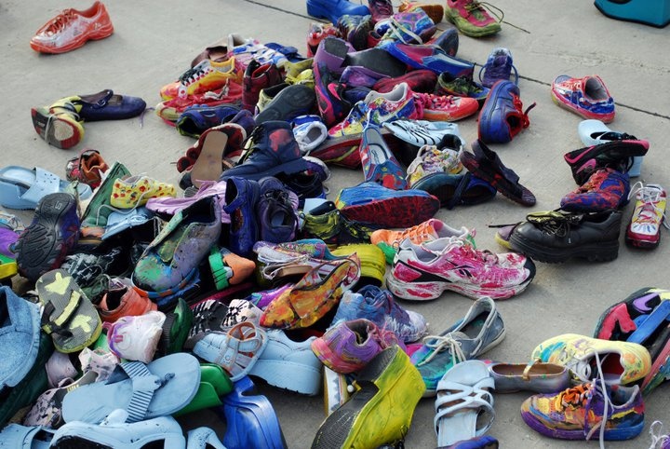
Why Strategic, City-Focused, Creativity-Infused Change Matters
International Council of Fine Arts Deans Conference
Grand Rapids
October 6, 2016
Notes:
Thanks Narric! I’m glad to have the opportunity to join this panel today and share our experiences in partnership with the US EDA to advance new research and recommendations to advance the creative and design industries in Michigan.

Slide 2
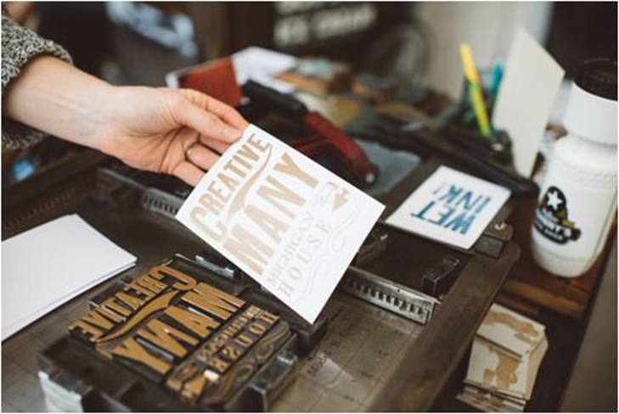
Creative Many Michigan
Developing creative people, creative places and the creative economy for a competitive MI – through research, advocacy, professional practice, funding and communications.
Notes:
First, a bit about Creative Many….Creative Many is the statewide economic development organization with the mission of developing creative people, creative places and the creative economy – for a competitive Michigan.

Slide 3
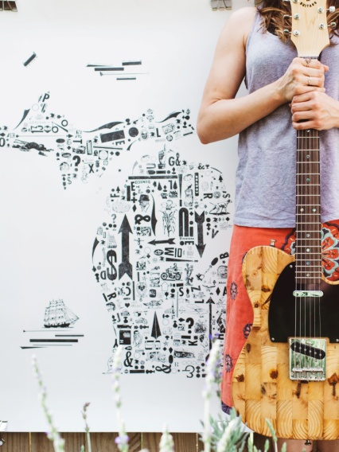
Power of Creativity in MI
Michigan’s creative industries contribute to the vibrancy of our communities, growth and prosperity of our economy, and the education of Michigan’s youth as the leaders and innovators for our future.

Slide 4
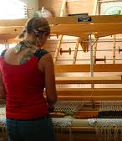
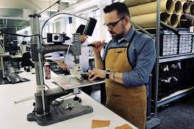
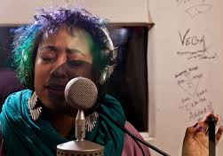
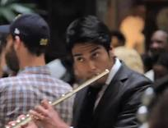
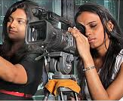
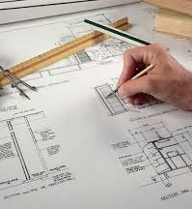

Michigan’s Creative Many
Artists, arts and cultural organizations, arts educators, makers, designers, and creative practitioners, entrepreneurs and businesses -- powerful economic/social forces statewide.
Notes:
First, a bit about Creative Many….Creative Many is the statewide economic development organization with the mission of developing creative people, creative places and the creative economy – for a competitive Michigan.

Slide 5
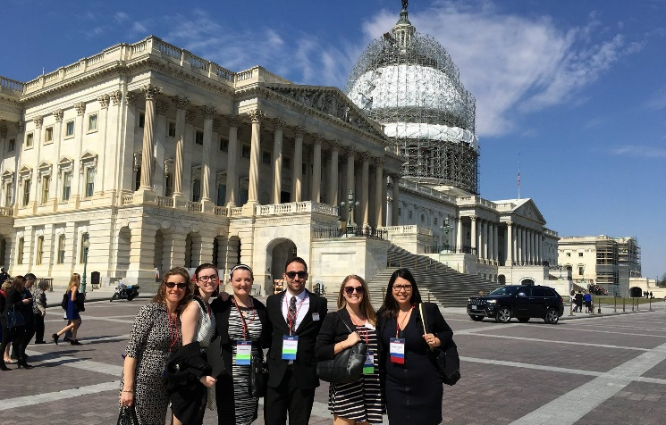
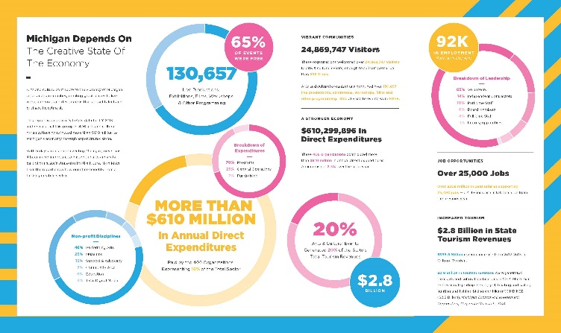
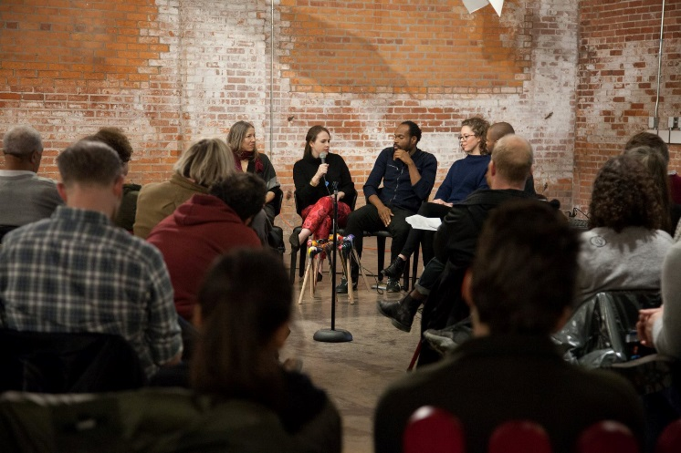
Our Portfolio
RESEARCH
Creative State MI Research/Reporting
ADVOCACY
Grassroots/Direct Lobbying
MI Legislative Creative Caucus
AFTA National Arts Education Pilot
PROFESSIONAL PRACTICE
Seminars + Summits
Kresge Artist Fellows PP
Lawyers for the Creative Economy
FUNDING
Resonant Detroit
Make+Do
Fiscal Sponsorships
COMMUNICATIONS
Networking & Dialogue Events
Online Alerts/Resources/Connections
Notes:
Our statewide work falls into three areas – advocacy to advance policies/diversified investment in Michigan’s creative sector, research/communications positioning the sector as essential to Michigan and its communities, and cultivating the work of artists and creatives through professional practice programs, dialogue and networking.

Slide 6

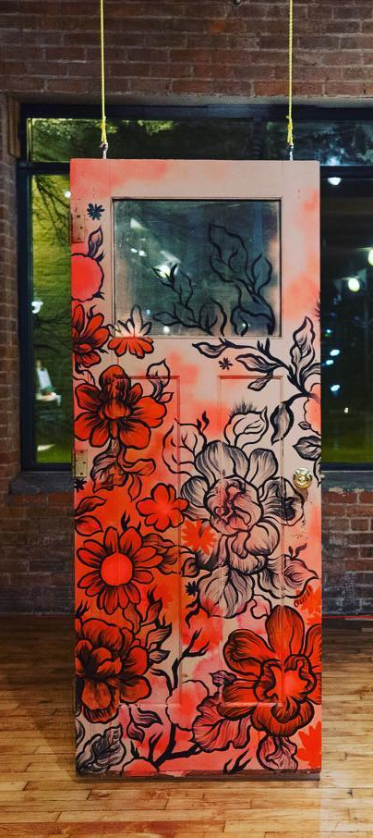
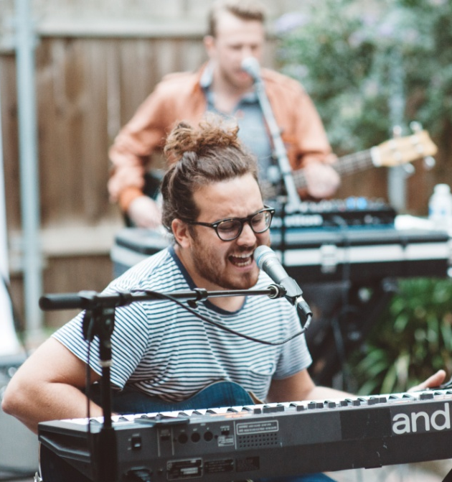

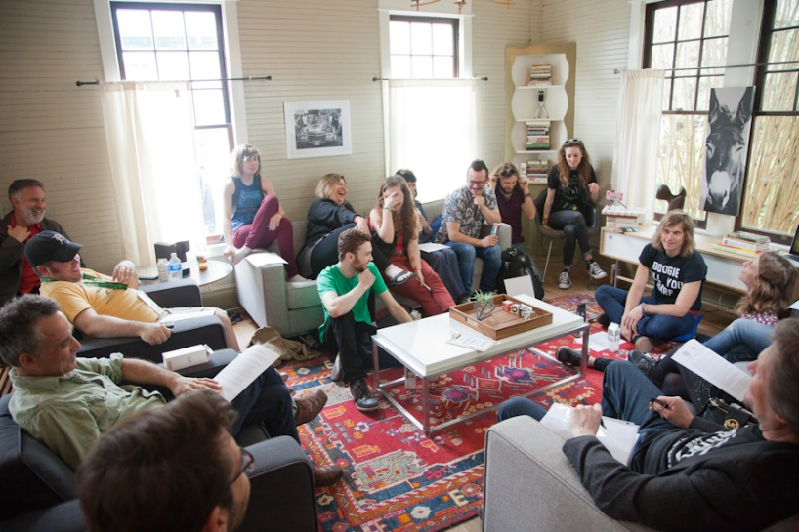
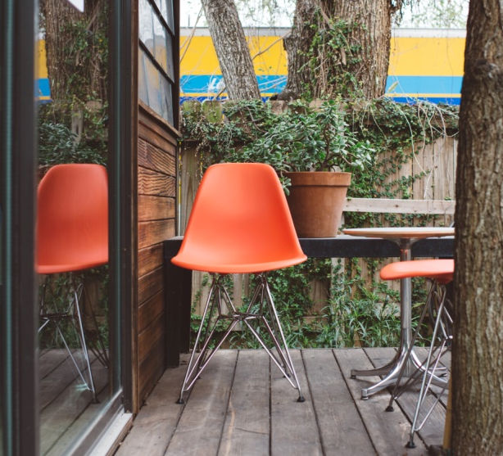
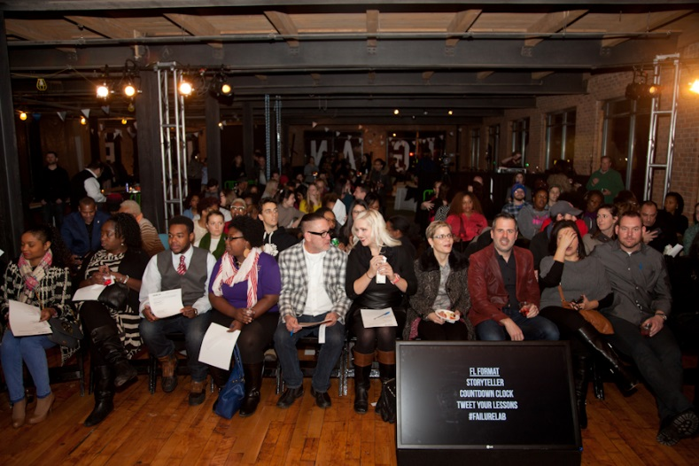
The Michigan House

Slide 7


Slide 8

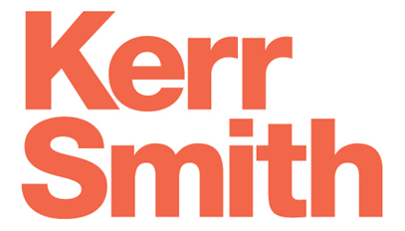

Our Partners
This study is made possible by the generous support of Creative Many’s funding and research partners:

Slide 9

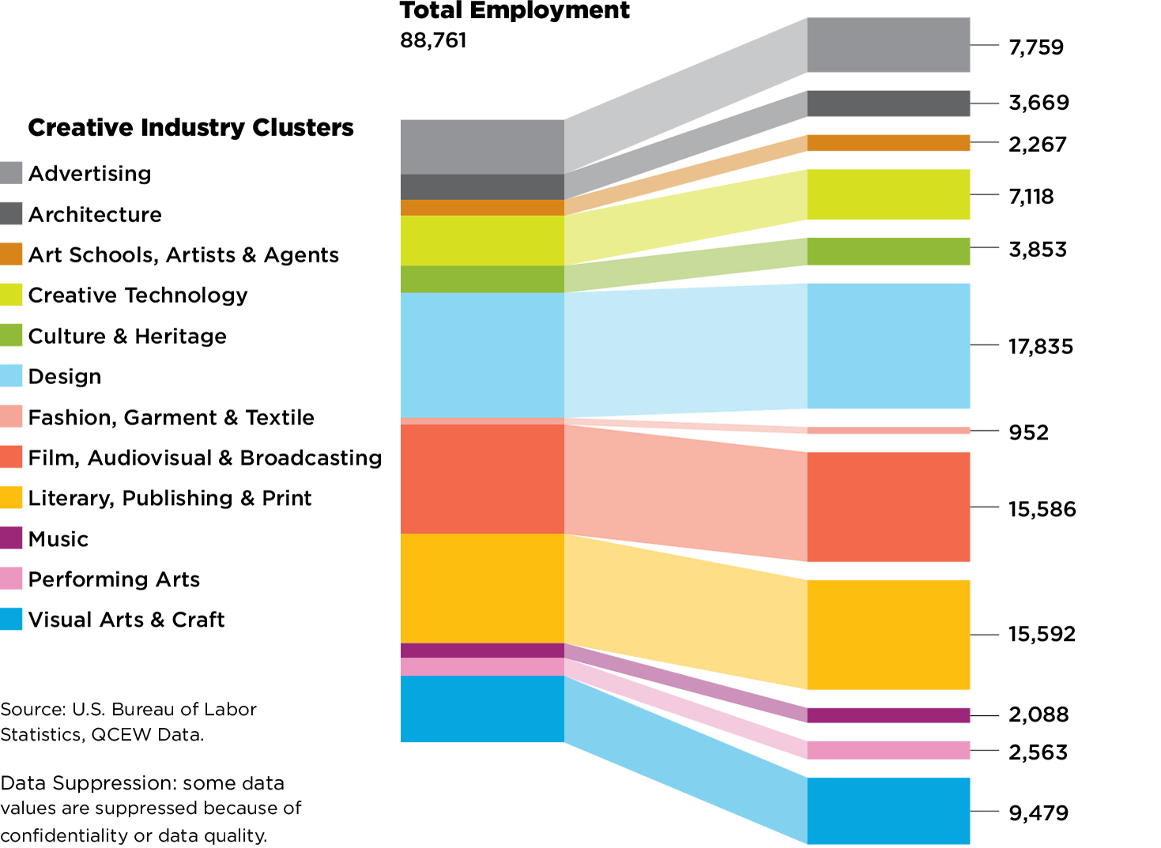
Who’s in the Creative Industries?
Notes:
Chart Page

Slide 10
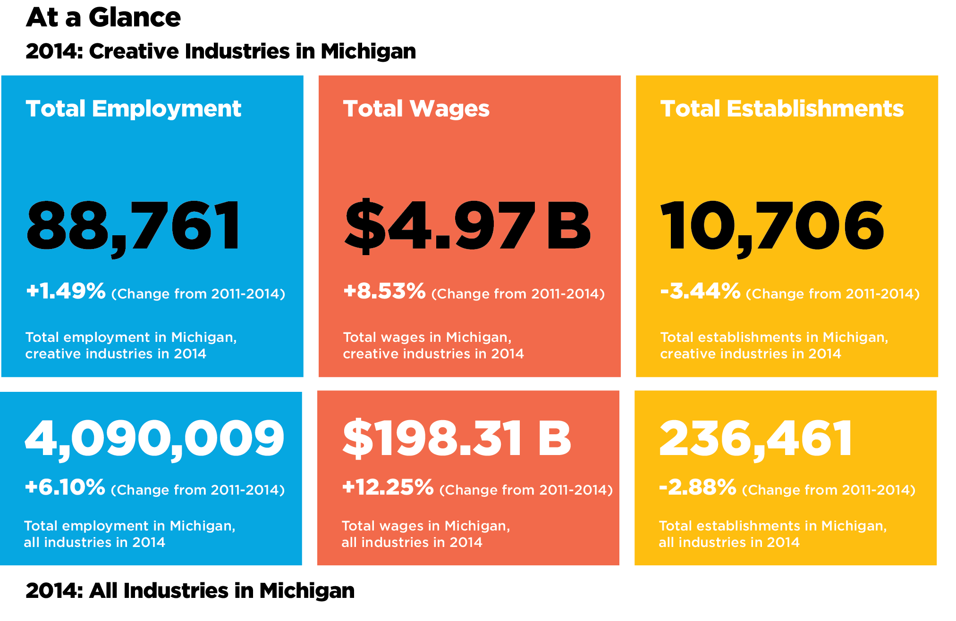
Michigan’s Creative Industries
Notes:
Chart Page

Slide 11
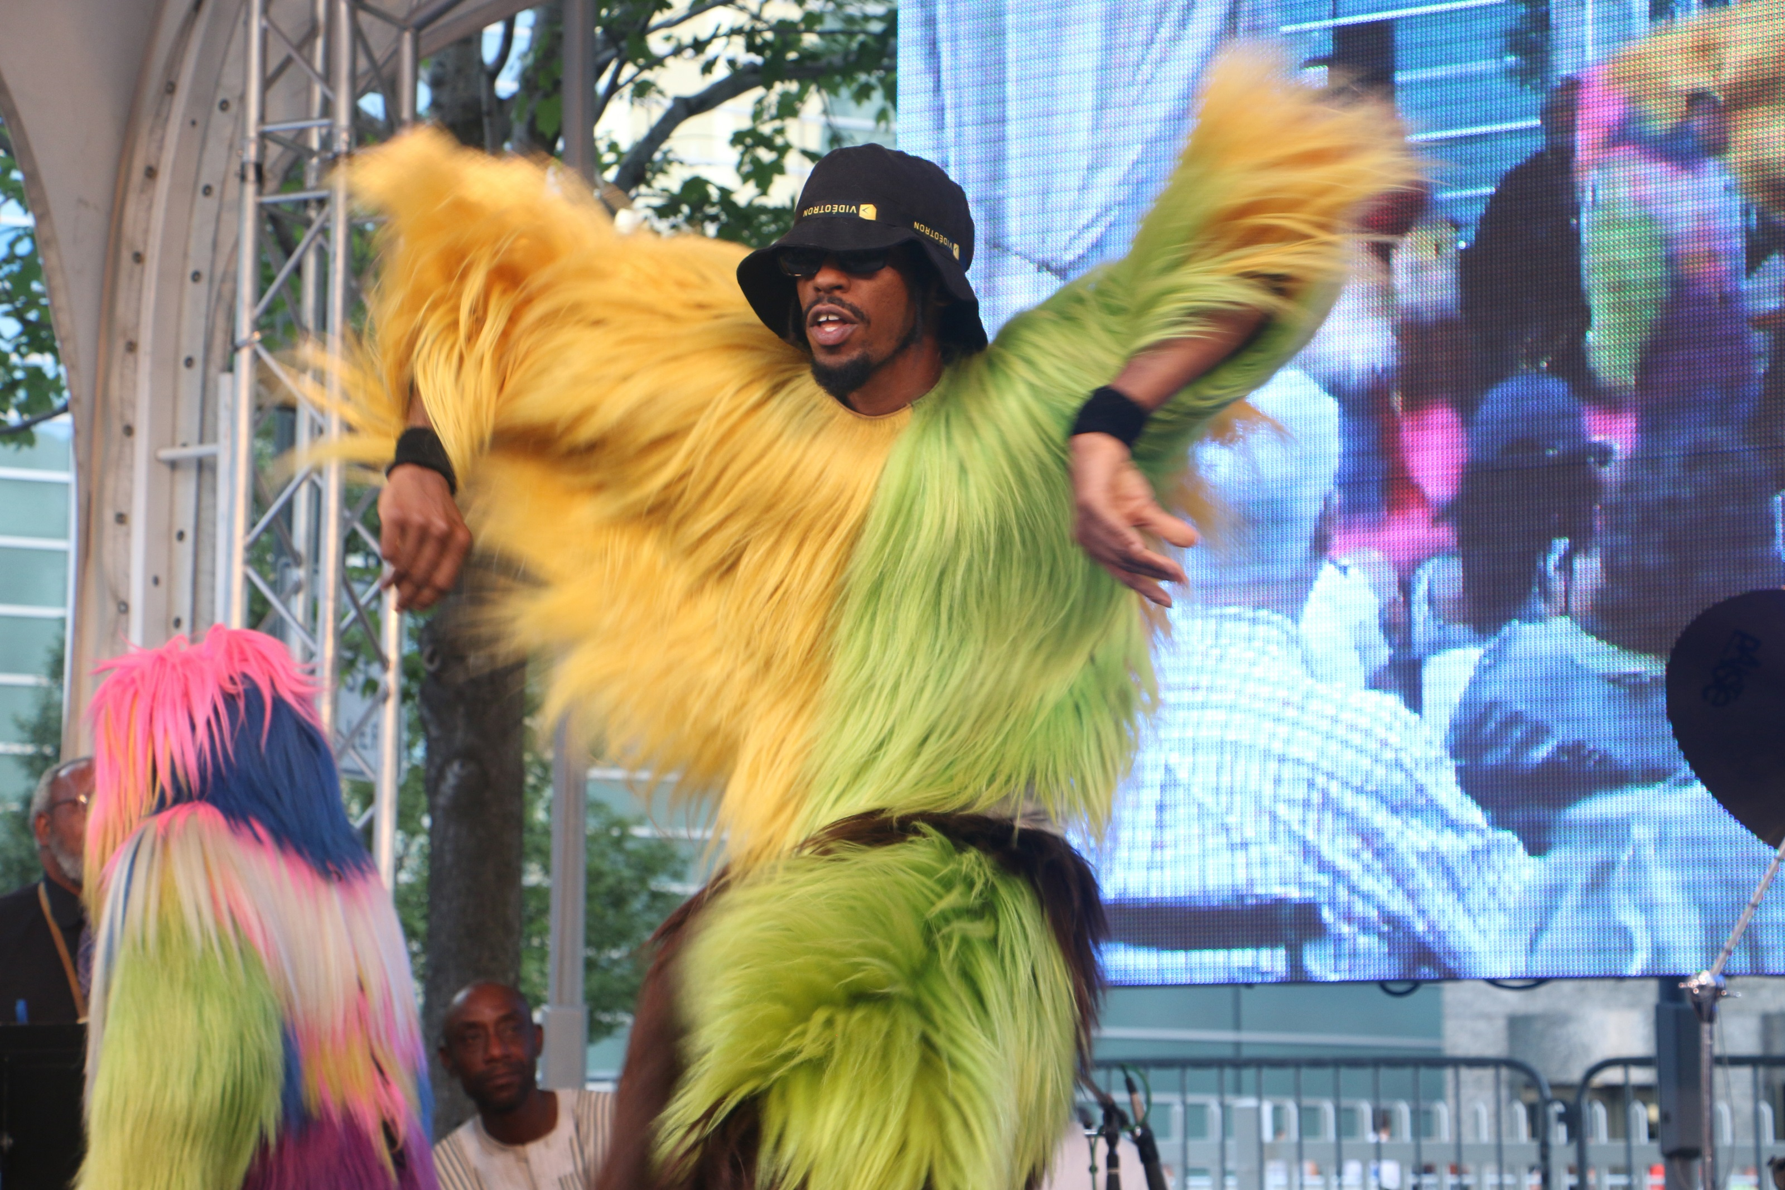
Transformation in Detroit
Notes:
Image Page

Slide 12
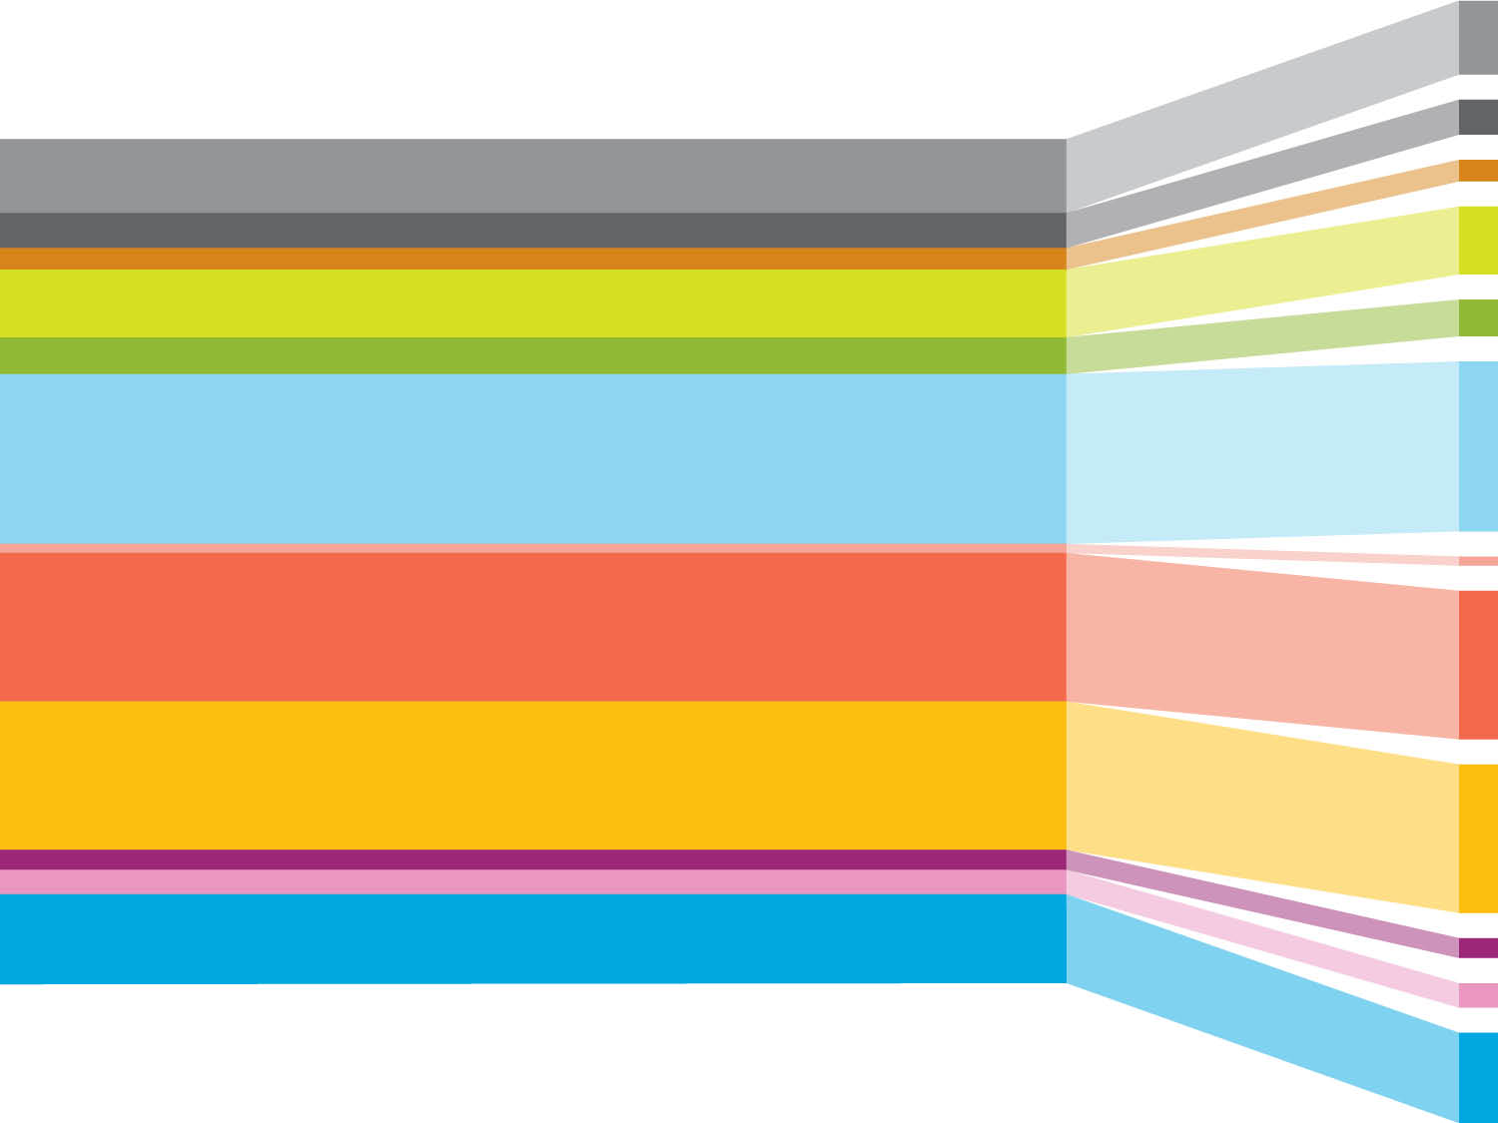
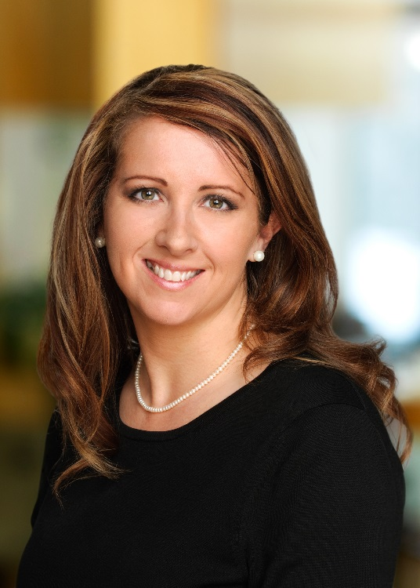
Helen Davis Johnson
VP Community Activation
Rock Ventures, LLC
Notes:
Divider Page

